Slide 1
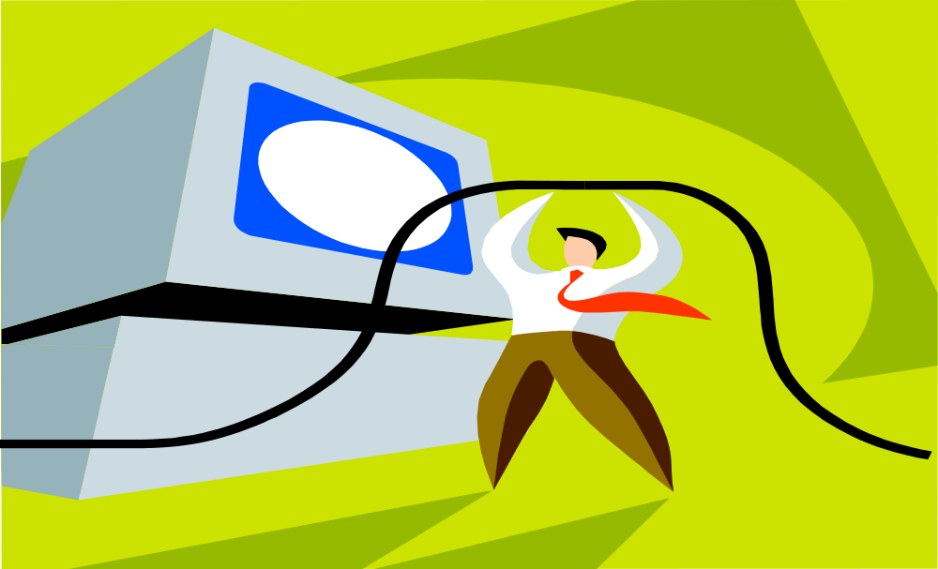
Basic Computer vocabulary

Slide 2
Table of Contents
What is a Computer
Computer Hardware
Examples of Computer Hardware
Computer Software
Computer Input Devices
Computer Output Devices
General Understanding of how your computer works
Basic Computer Quiz
Answers to Basic Computer Quiz
Basic Computer Terms and Definitions

Slide 3

Definition of Computer
A device that computes, especially a programmable electronic machine that performs high-speed mathematical or logical operations or that assembles, stores, correlates, or otherwise processes information.
Go back to Table of Contents

Slide 4

Computers Have Two Main Parts
Computer Hardware
Computer Software

Slide 5
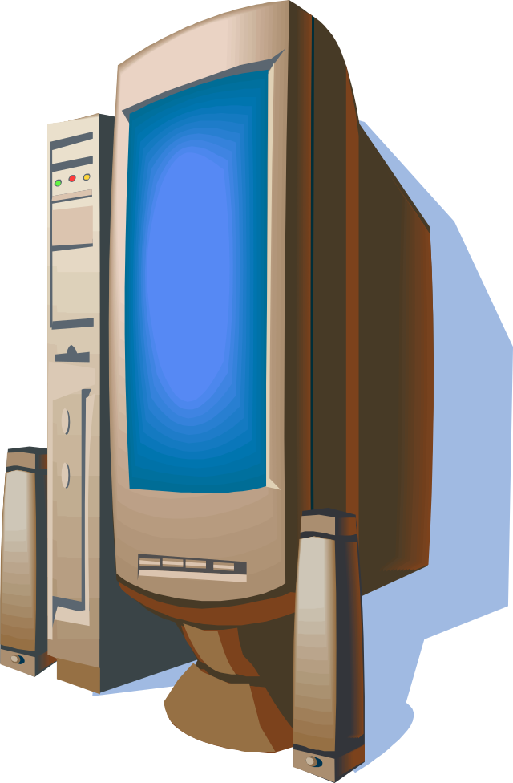
What is Computer Hardware?
Computer Hardware is the physical part of the computer system, the machinery and equipment.
Parts of the computer “you can see”
Go Back to Table of Contents

Slide 6
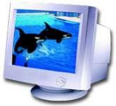
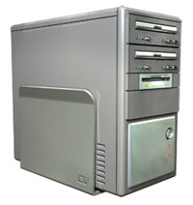
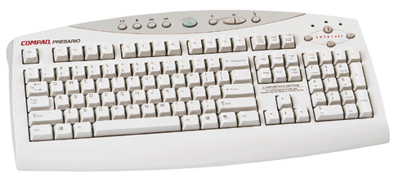
Examples of Computer Hardware
Monitor: T.V. like screen used to show pictures and words
CPU: Central Processing Unit this is where most of the computer’s calculations take place. In terms of computing power, the CPU is the most important element of a computing system.
Keyboard: This device is used to type information into the computer and contains the numbers 0-9.
Click Here for more Examples

Slide 7
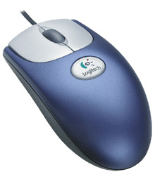
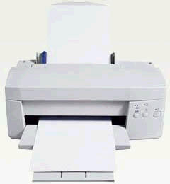
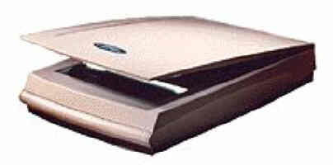
More Computer Hardware
Mouse: a small device, which you move across the top of the desk to move the pointer or cursor on the screen.
Printer: used to make a paper copy of the information into the computer.
Image Scanner: an electronic device that generates a digital representation of an image for data input to a computer
Go Back to Table of Contents

Slide 8
What is Computer Software?
Computer Software are programs that tell the computer what to do.
Examples
Microsoft Word-word processing program
Microsoft PowerPoint-presentation program
Microsoft Excel-work book program used to track, calculate, and analyze numeric data
Go Back to Table of Contents

Slide 9
Computer Input Devices
Computer Devices that input information in the computer
Examples
Key Board
Mouse
Scanner
Digital Camera
Go Back to Table of Contents

Slide 10
Computer Output Devices
Computer Devices that output information from the computer.
Examples
Monitor
Printer
Go Back to Table of Contents

Slide 11
General Understanding of how your computer works!
Overview
To understand anything it helps to break it down into it's basic components. Then you need to know how each component works. Finally you look at how all the components work together to achieve the desired end product or result.
Motherboard
It is the main circuit board inside the CPU case. It holds the microprocessor, memory and other crucial circuits and components that control the operation of the Personal Computer. Every device inside or connected to a Personal Computer finds it's way to this board.

Slide 12
Memory
The mother board takes the input you give it like mouse clicks, and produces output for you like displaying or printing a file. It can't do this without memory. The PC operating system used by the PC is copied from storage to memory at power up. The OS copy in memory then runs the PC. Memory is volatile which means that when your PC is turned off the contents of memory are lost. It is completely blank and must reloaded each time the PC is powered up.
Storage
Storage is non-volatile which means it retains information even when it is powered off. It stores programs which run the PC as well as data, which is a digital form of everything you use like documents, music, pictures, etc
Input Devices
The keyboard and mouse are the main input devices you use to control your PC.

Slide 13
Output Devices
When you send inputs into the PC, it processes them and produces useful output for you. The primary output devices are the video display, printer and speakers.
Software
Some people want to use the power of their computer to create works of art, others want to create music, or play games, surf the web, or play the stock market. Whatever you want to do with your computer, software is the key to doing it.
What happens when your PC is powered on?
With a simple push of a button, your computer comes to life.
Go Back to Table of Contents

Slide 14
Basic Computer Terms and Definitions
CPU: This computer component has several names: Central Processing Unit, microprocessor or processor. This unit is the brain of the computer processes and executes instructions in a software program. The CPU’s primary functions include retrieving instructions from the computer’s memory, including random access memory, comprehending and executing instructions, and directing the input and output activity of the computer.
Desktop: The first screen that you see when any Windows operating system screen is up and running. One of the main purposes of the Desktop is to make it easier to access different application programs, files and documents.
File: Unit for storing information that may include a word-processing document, a spreadsheet, a picture, a graphic, musical piece, or even part of an application program. Examples of "files" include text files which could be a letter or report and graphic files which could be a picture. Each file has a name because the data or information created in a software program is saved with a file name.
Folder: Method for organizing files that is related by topic, by purpose, by type, by program, or even by a project that you are working on. NOTE: When an application program is loaded onto your computer, it will group similar applications in a folder. As you add or create files, you can organize them however you want.

Slide 15
Hyperlink: Allows you to move from one web page document to another. It can be text which is usually underlined or a graphic. When you move your mouse over a hyperlink, the mouse cursor usually becomes a hand which indicates a hyperlink is present. Once you click on the link, you move to another web page document or to another place on the same web page.
Icon: A small picture that represents processing options such as programs, documents, and shortcuts. When you click on the icon, the file or program will open. The most easily recognized icon is the Recycle Bin which is the graphic below.
Input: Commonly known as data and refers to numbers, letters, words, images, video, music and even sounds. Other computer input includes commands and user response. A command directs the computer to execute tasks or perform certain activities. One example of a command is a command buttons OK, Cancel and Help seen on the Shut Down Windows dialog box.
Internet: A world wide network that connects millions of computers to share and exchange data, news, opinions, and research results. The Internet is not the same as the World Wide Web (WWW). The World Wide Web is a service that is provided on the Internet.
Keyboard: The keyboard is an input device that allows you to enter letters, numbers and symbols into your computer. The keyboard keys include the alphanumeric keys (letters and numbers), numeric keypad, special function keys, mouse cursor moving keys, and status lights.

Slide 16
Files and Folders: Think of a computer folder as being similar to a filing cabinet folder, whereas a computer file is similar to the pieces of paper that are placed in the folders.
Graphic User Interface (GUI): Combines text and graphics to make software easier to use. Graphical User Interface features include icons, windows, menus, and buttons.
Hard Copy: Usually refers to a printout on paper.
Hard Drive: The purpose of the hard drive is to store information. This device that allows the computer to permanently retain and store data like the operating system, programs and information data. The hard drive holds more data than a diskette and accesses information faster than on diskettes. Storage refers to the capability of storing things, and as for the computer, it is information.
Hardware: Refers to any component of the computer system that you can like the monitor, keyboard, mouse, printer, computer unit, scanner, speakers and even the components inside of the computer unit if you opened the box up.

Slide 17
Menu: List of options that may be commands or other options from which you can choose from. The following illustration is the File Menu Bar command menu list.
Mouse: Besides a keyboard, a mouse is the most common input device for a computer. The mouse is a small, palm-sized input device that you move across a flat surface, such as a desktop, to control the movement of the pointer on the screen. Technically, there are many operations that are much easier to perform with a mouse than a keyboard because you can just point and click to select an item on a screen or choose an item from a list of options.
Mouse Commands: Before examining the various commands, you must understand how to execute each mouse command. The mouse commands include move, point, click, deselect, double-click, drag, and right-click.
My Computer: An icon that opens into a folder of icons for all of the resources on the computer like the hard drive and printer.
Operating System: Software that acts as an interface between you, the application software (like word processing or accessing the Internet), and the computer components. This includes interpreting and carrying out basic instructions that operate a computer like recognizing information from the keyboard and mouse, sending information to the monitor, printer, or speakers and scanners, storing information to the hard drive and removable drives. Common operating systems include Windows XP, Windows 2000, Windows ME, and MAC OS.

Slide 18
RAM: This is an acronym for Random Access Memory. This memory is a work area or a temporary storage space where the computer places program information so that it can execute the program instructions and information. When the program or file is closed, the data or programs are removed from RAM. The amount of RAM you have on your computer is crucial in determining how many programs can be opened (running) and how much data is available for each program. RAM is available in MB or megabytes. An example is 256MB of RAM.
Select: A single left mouse click to select a file or folder icon.
Software: Instructions that provide the computer with step-by-step actions that need to be executed to complete a specific task. A computer will not function with software.
Go Back to Table of Contents

